Slide 1
Title: Exploring the Impact of Weather Conditions on Bike Ridership
A Data Wrangling Approach in Python
by:-PUJA MEHTA
Date:22-12-2023

Slide 2
Abstract:
This project presents a comprehensive approach to data wrangling using Python,
aimed at transforming raw data into a more usable format
for downstream data analysis and machine learning applications.
Leveraging powerful Python libraries such as Pandas, NumPy, and Matplotlib,
we developed a robust pipeline for cleaning, transforming,
and visualizing complex datasets.
Our methodology involved handling missing data, outliers,
and inconsistent data entries, as well as reshaping data structures for optimal analysis.
Content:
Introduction
Objectives
Methods
Conclusion

Slide 3
1. Introduction:
The increasing popularity of bike-sharing programs across the globe has led to a surge in the availability of bike ridership data.
This data, often complex and unstructured, presents a unique opportunity for researchers to uncover patterns and trends in bike usage.
One such area of interest is the relationship between weather conditions and bike ridership.
However, the raw data available is often messy and requires significant preprocessing before meaningful analysis can be conducted.
This paper presents a comprehensive approach to data wrangling using Python, aimed at cleaning, transforming, and enriching a dataset of bike ridership in relation to weather conditions
Our research leverages Python's powerful data manipulation libraries, such as pandas and NumPy,
to handle missing data,outliers, and inconsistent entries. We also reshape the data structures for optimal analysis and create new features from existing data to provide additional insights.
The cleaned and transformed dataset is then used to explore the impact of various weather conditions on bike ridership.
This paper underscores the critical role of data wrangling in the data science workflow and highlights Python's capabilities in handling such tasks effectively and efficiently.
The findings from this research will provide valuable insights for city planners, bike-sharing companies, and policymakers to make data-driven decisions and improve bike-sharing programs.

Slide 4
2.Objectives: Data Wrangling
Data wrangling, also known as data munging, is the process of cleaning, structuring and enriching raw data into a desired format for better decision making in less time. It involves data cleaning, data transformation, and data integration steps to discover useful information or to support decision-making applications.
Includes following methods:
Data Acquisition
Data Exploration
Data cleaning
Data transformation
Data Integration
Data Filtering (if required)
Data Validation
Data Export

Slide 5
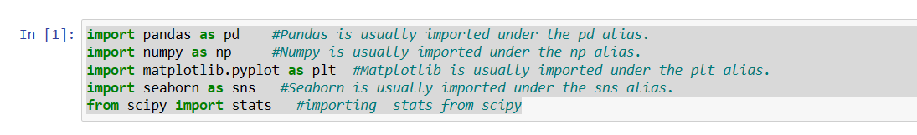
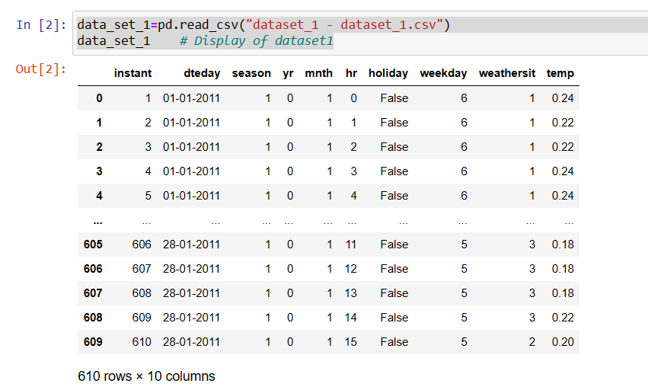
3. Methods:
Importing necessary python libraries:
2.Data Loading: Obtain the data from various sources such as databases, files, APIs, web scraping, etc using pandas.
NOTE: all 3 datasets where loaded in same way

Slide 6
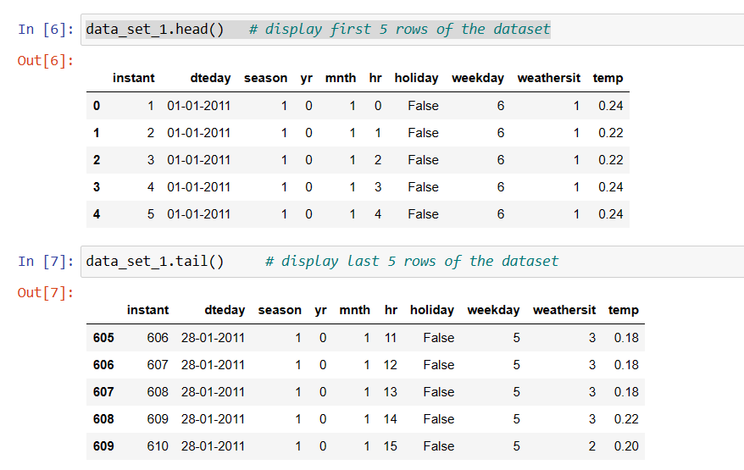
3. Data Exploration / Understanding the data/Viewing Data from the loaded datasets
One of the most used method for getting a quick overview of the DataFrame, is the head() method & tail() method.

Slide 7
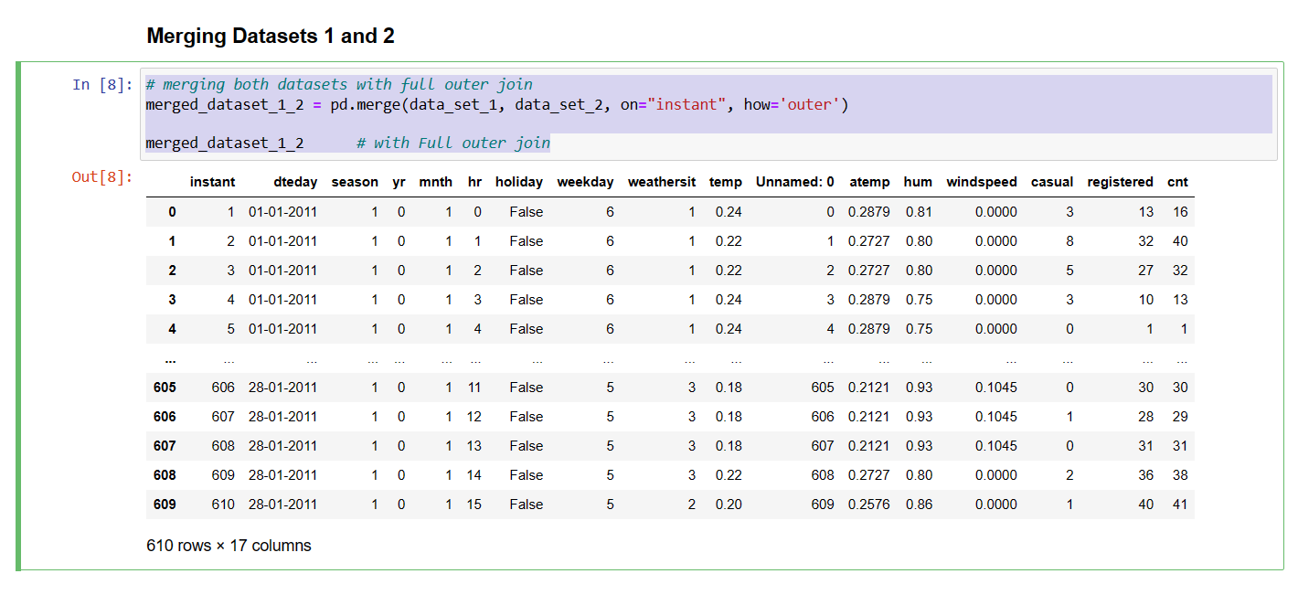
4. Merging Datasets 1 and 2

Slide 8
5. Data Cleaning: Handle missing or null values, outliers, duplicates, inconsistent data, etc., to improve the quality and accuracy of the data.
Dropping unnecessary features from the dataset
Finding null values
Treating null values
Changing datatypes of the features into integers or float data type
6. Checking the skewness and correlation of the data.
# Calculate the skewness
skewness =final_dataset.skew()
print("Skewness:\n", skewness)
# Calculate the correlation
correlation = final_dataset.corr()
print("Correlation:\n", correlation)

Slide 9
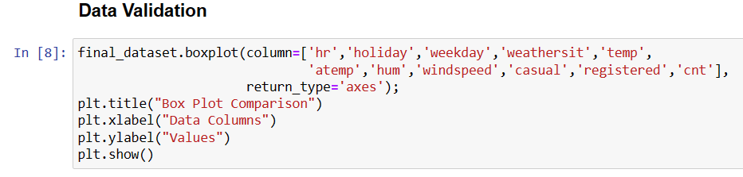
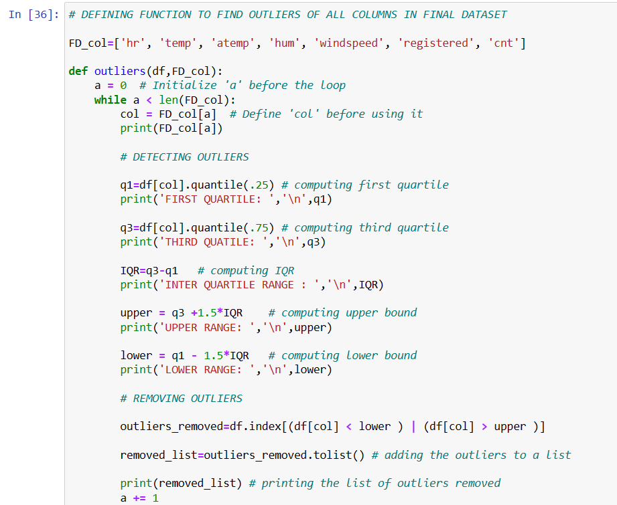
7.Detecting and removing of Outliers:
8.Data Export: Save the wrangled data into various formats or destinations for further analysis, visualization, or machine learning, such as CSV, Excel, SQL, etc.
final_dataset.to_excel("Cleaned_final_dataset.xlsx")

Slide 10
Conclusion:
Based on the information available, a potential conclusion for a data wrangling project in Python on bike ridership in relation to weather could be:
“After extensive data wrangling and analysis of the bike ridership dataset, it was observed that weather conditions significantly impact bike rental demand. The demand for bike rentals tends to increase during favorable weather conditions and decrease during harsh weather conditions. Furthermore, other factors such as the day of the week also play a crucial role in determining bike rental demand. The insights gained from this analysis can be used to accurately forecast bike rental demand, thereby helping bike-sharing companies optimize their operations

